Slide 1
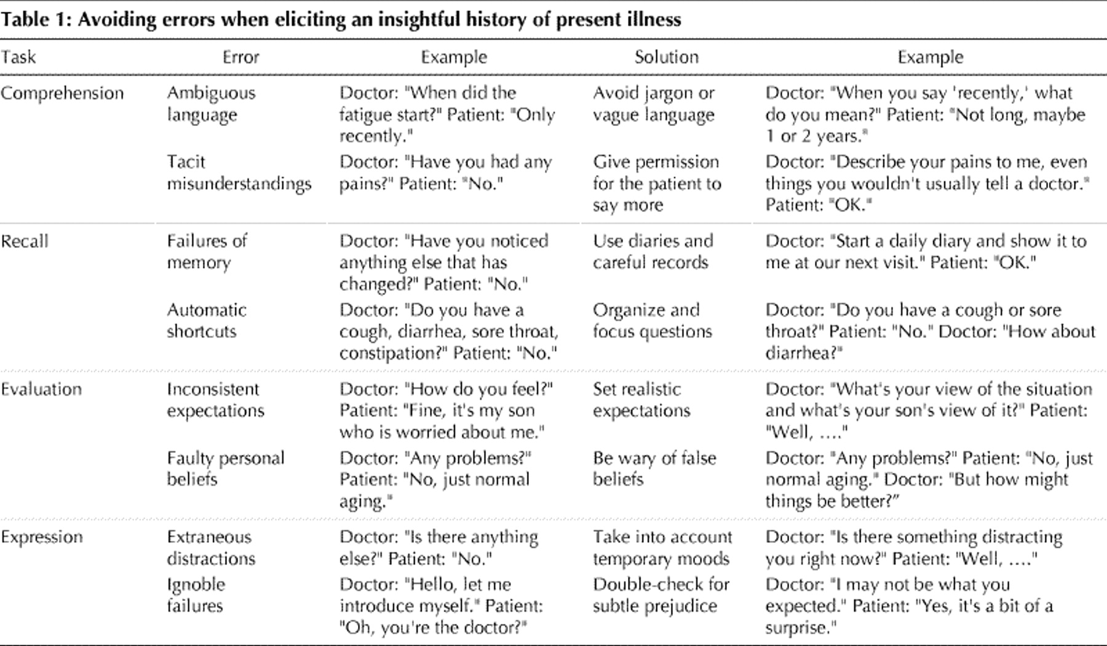

Table 1. .
Donald A. Redelmeier et al. CMAJ 2001;164:647-651
©2001 by Canadian Medical Association
Notes:
Table 1.

