Slide 1
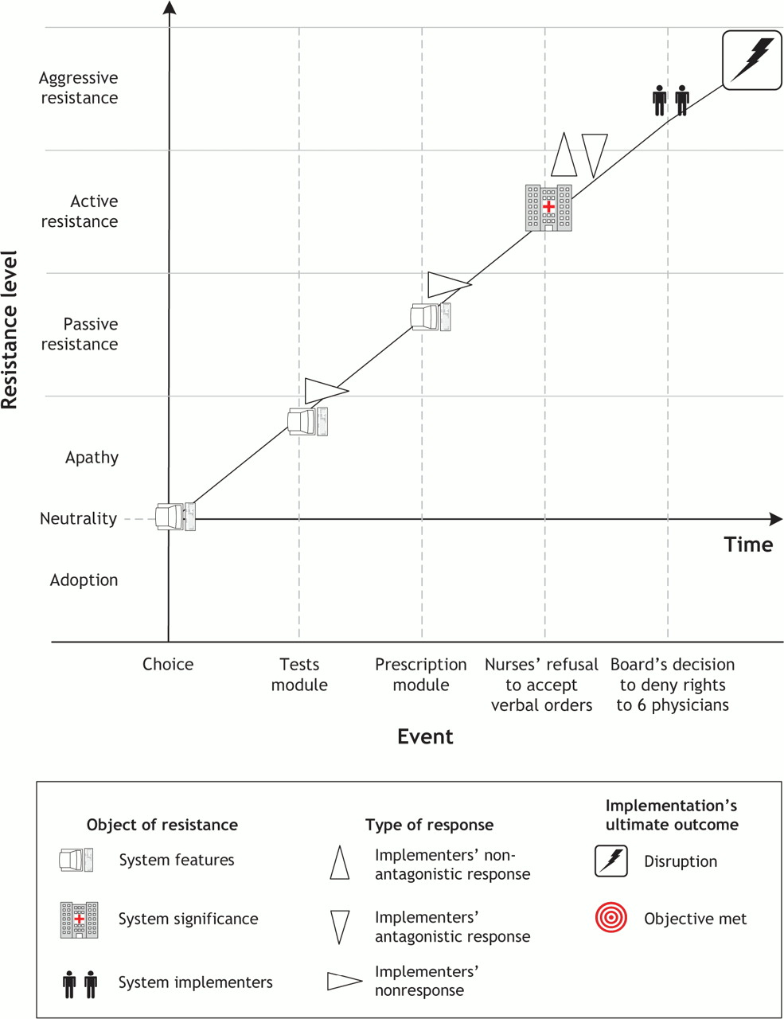

Fig. 1: Case 1: Evolution of resistance behaviours during implementation of computer information system (CIS) in community hospital.
Liette Lapointe, and Suzanne Rivard CMAJ 2006;174:1573-1578
©2006 by Canadian Medical Association
Notes:
Fig. 1: Case 1: Evolution of resistance behaviours during implementation of computer information system (CIS) in community hospital.

